Slide 1
The goal of the project: Prediction of the odor intensity of fragrance molecules The real word problem:
Odor intensity determines how much of an ingredient is needed in a fragrance formula (quantity ~ cost).
Intensity as a function of concentration is essential for fragrance design and reformulation.
Highly intense ingredients are economically attractive because lower dosages are required.
Experimental intensity measurements are costly, slow, and require trained sensory panels.
Predicting intensity from molecular properties could accelerate ingredient discovery and reduce R&D costs.
The mechanisms of odor perception are not fully understood, and fragrance development still relies heavily on expert knowledge and experience
Notes:
Couple of word about fragrance industry – this is multibillion dollar market; we have the smell almost in every consumable product, usually commercial formulas have 30 -150 ingredients where most of them a synthethic, naturals ingredients are not better. Target price from 10-30 $/kg. In terms of business: Product - > Brief -> Fragrance house -> Development -> delivery to CPG companies. Development and maintenance of the formulas are mainly performed by perfumers (art -> experience -> trials and errors -> difficulty to predict -> very time-consuming process)
2. Evaluation of smell ingredients and mixtures is challenging, somewhere subjective, needs training and still not possible with e-nose.
Odor intensity - > quantity, character of smell, cost
Mechanism od odor perception is still not understood

Slide 2
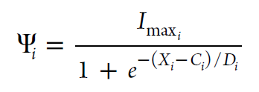
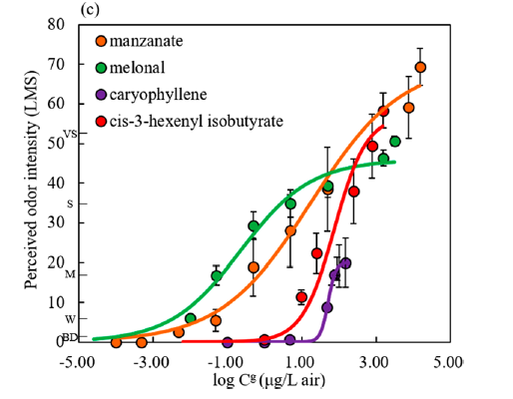
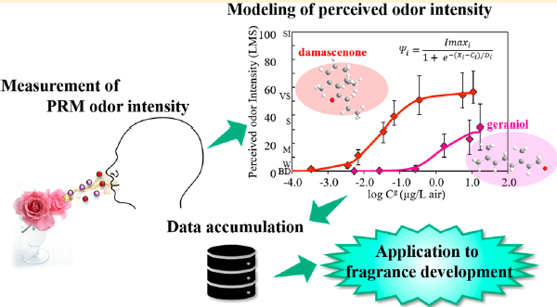
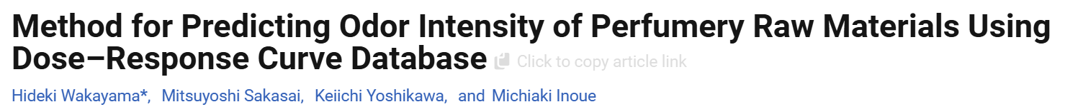
Intensity behavior (different threshold)
Odor intensity is measured by labeled magnitude scale (LMS), which is hybrid scaling technique using verbally labeled line with quasi-logarithmic spacing between the labels.
Ind. Eng. Chem. Res. 2019, 58, 32, 15036–15044
Notes:
As a data set, we use published research made by KAO corporation, in the frame of this research the intensity of 314 PRM was measured
Labeled Magnitude scale was used for perceptual evaluation, Intensity was measured against concentration of odorants in air
3-5 panelists randomly selected from group of 18 measures every concentration point
Sigmoid behavior of intensity curve (different threshold concentration, steepness of curve, concentration with half Imax, and I max plate

Slide 3
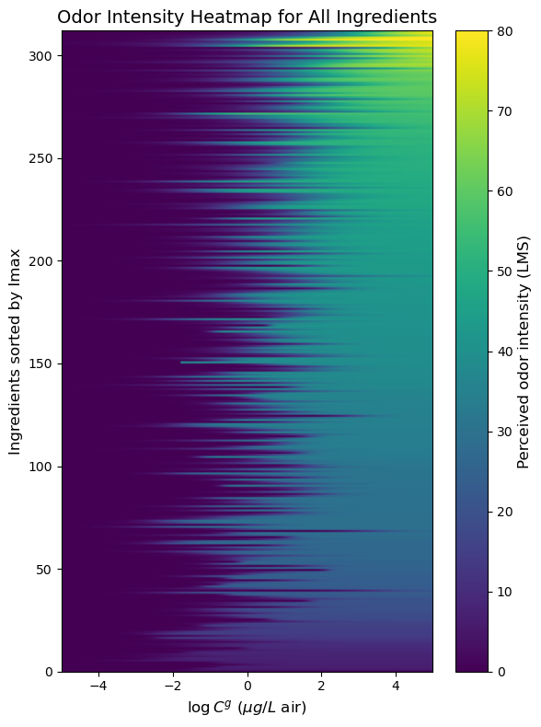
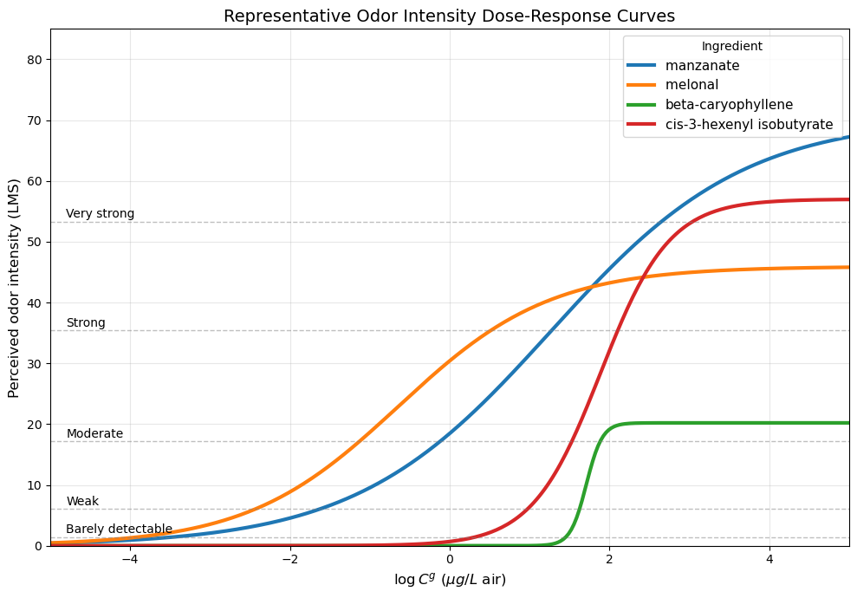
Visualization of data with Python

Slide 4
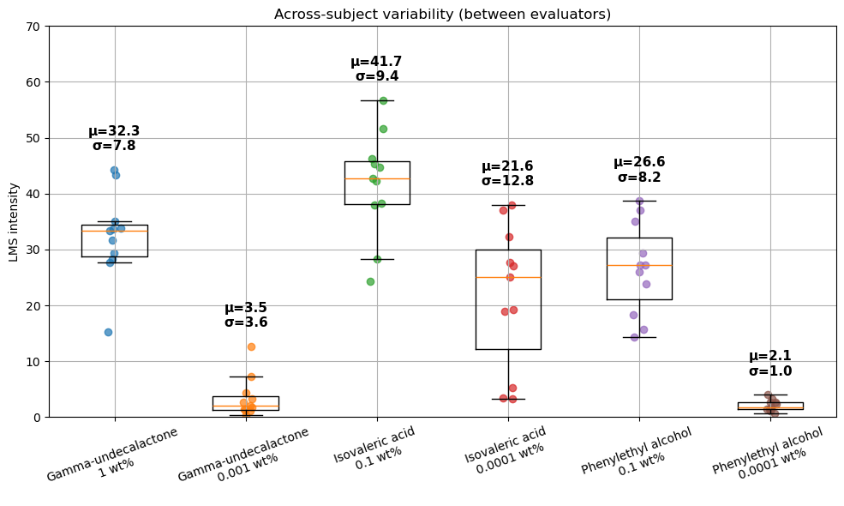
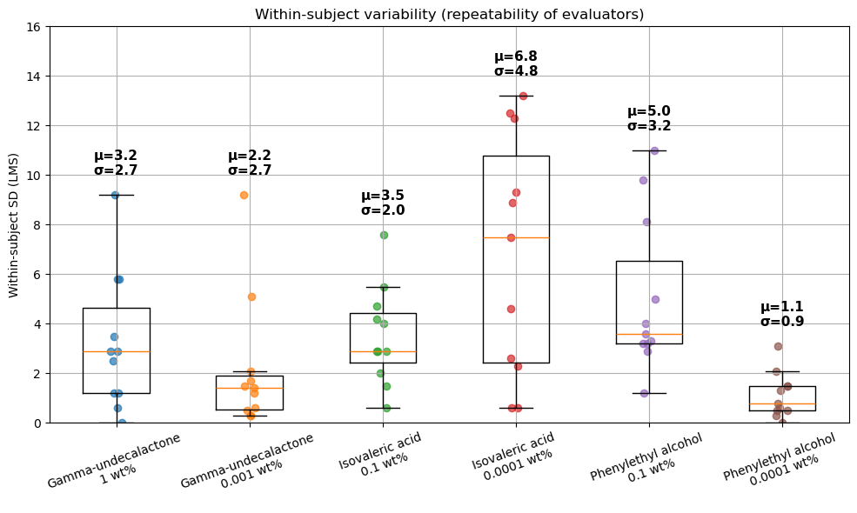
Performance Target Selection:
The supplementary sensory data allow us to quantify the variability of odor intensity assessments.
Source of uncertainty | Typical magnitude
Within evaluator | ~3–5 LMS
Between evaluators | ~8–13 LMS
Target | Model performance level
MAE < 12 LMS | Useful predictive model
MAE < 8 LMS | Comparable to evaluator uncertainty
MAE < 6 LMS | Approaching measurement noise level
Selected project metric: Mean Absolute Error (MAE) Target performance: MAE < 8 LMS, corresponding approximately to the typical between-evaluator variability observed in sensory assessments.
Notes:
Each dot represents the average score of one evaluator. The box shows the middle 50% of evaluators, and σ shows the standard deviation between evaluators. For several conditions, σ is around 8–13 LMS units, supporting MAE ≈ 8 LMS as a reasonable target for model performance.

Slide 5
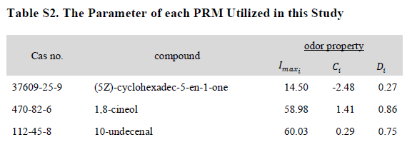
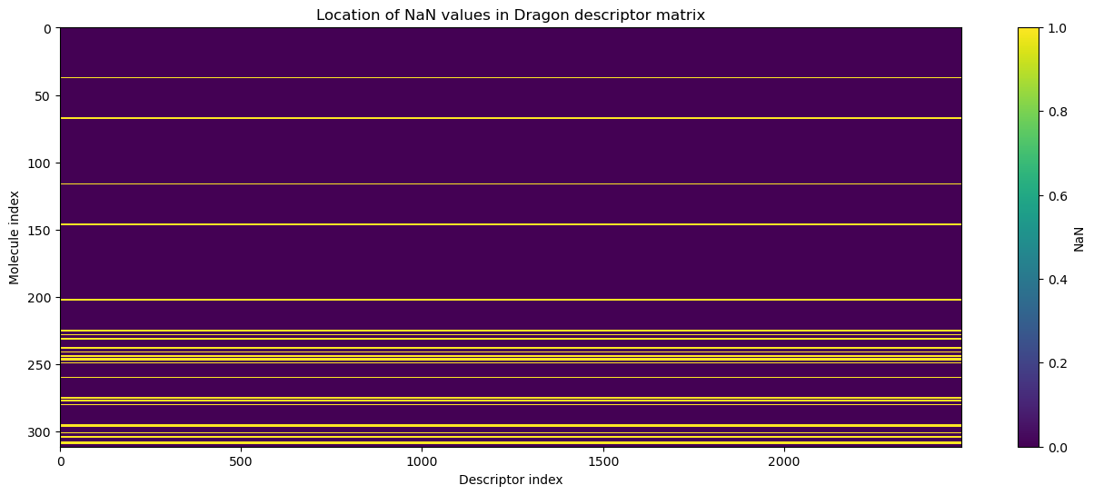
What do we have as an initial data?
https://www.talete.mi.it/products/products.htm
Dragon, computational data set for molecules
2491
4065
312
......
Merge between target and feature -> 282 molecules
Also, the following predictors can be relevant:
~ vapor pressure (std. condition)
~ boiling point (std. condition)
~ Alpha-shape
~ MLogP
~ RDKit Library

Slide 6
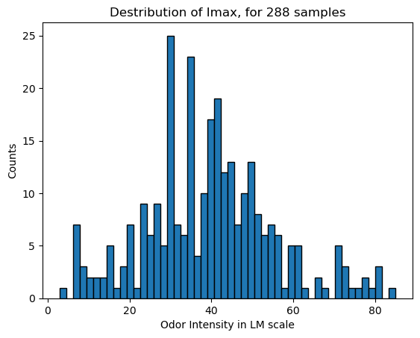
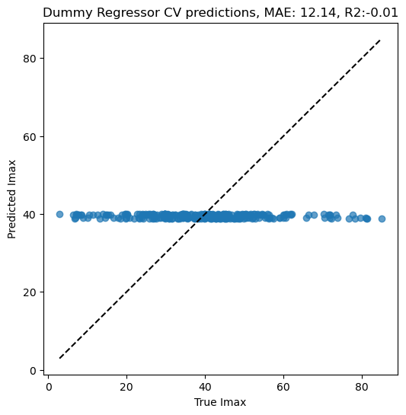
Distribution of Imax

Slide 7
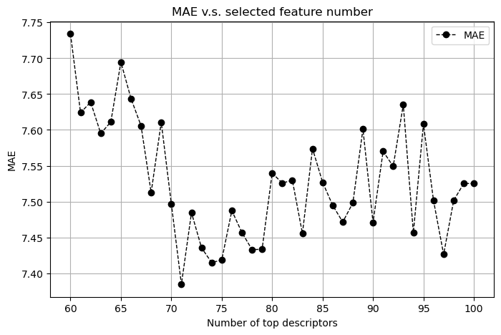
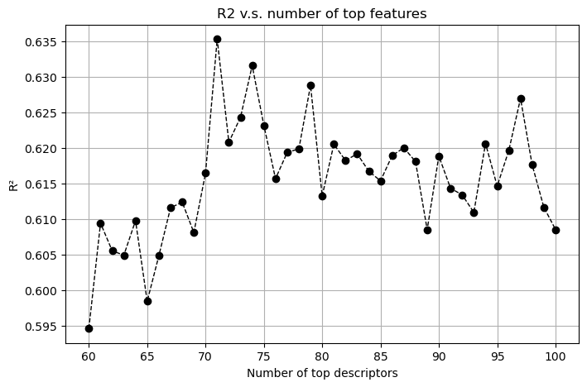
Features Engineering :
Merge between target (Waka data set) and Features matrix - > 30 sample drops, we stay with 282 samples
Dropping of features with zero variance
Dropping of features with correlation above 0.95 -> stay with 834 features from initial 2491
Running of XGBOOST for features importance (not tunned, and not CV-ed)
Selection of the top 71 features
Comprehensive GridSearch - > selection of best params - > Cross Validated prediction

Slide 8
Dummy predictor as a base-line for comparison

Slide 9
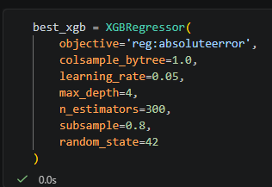
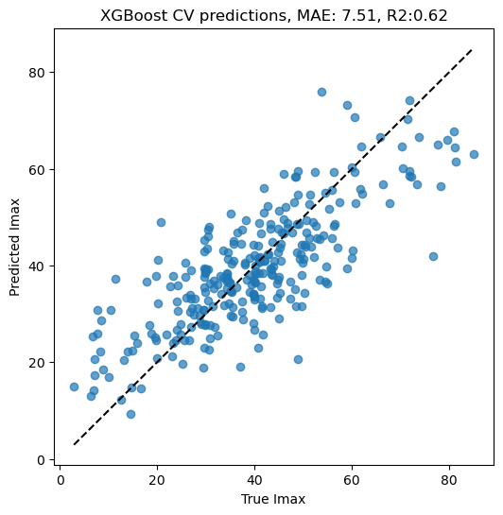
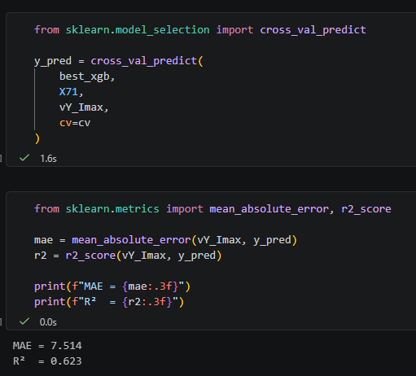
CV Prediction on 5 folds, on top 71 Dragon features set
Notes:
MAE less sensitive for outlayers
subsample=0.8, Percentage of rows used to build each tree.
colsample_bytree=1.0 Percentage of features used by each tree.

Slide 10
Top 71 descriptors selected by XGBOOST:
['ATS6m', 'Vindex', 'RDF015s', 'MPC08', 'SpMaxA_AEA_dm_', 'Eig07_AEA_dm_', 'RDF065s', 'SpMax6_Bh_s_', 'ATS5m', 'HATS0v', 'SpPosA_RG', 'GGI6', 'Mor08m', 'VE3_RG', 'VE2_B_m_', 'Eta_betaS_A', 'SM11_AEA_bo_', 'RDF010s', 'H2v', 'Mor03v', 'SpMax7_Bh_s_', 'RDF050m', 'Mor11u', 'ChiA_B_m_', 'VE3sign_B_v_', 'G2m', 'SM12_AEA_bo_', 'R6u', 'HATS8m', 'ATSC8e', 'TDB01m', 'SpMax2_Bh_s_', 'RDF025s', 'Mor05m', 'ZM1Mad', 'HGM', 'TDB10u', 'ATSC6m', 'Mor11v', 'Mor05v', 'GGI3', 'Am', 'Mor07m', 'VE1sign_B_v_', 'R5s', 'H3u', 'AVS_B_s_', 'SpMax6_Bh_m_', 'SM09_AEA_dm_', 'H6s', 'Mor04v', 'MATS1e', 'SpMin1_Bh_s_', 'RDF025u', 'Mor29u', 'JGI2', 'H7s', 'ATSC1e', 'MATS1v', 'Mor13m', 'HATS0p', 'VAR', 'R6v', 'TDB06m', 'Gm', 'RDF060m', 'SsOH', 'Mor11p', 'Mor03s', 'Mor10s', 'Mor32v']
Strongly represented:
3D molecular shape and geometry
Molecular size and bulk
Electronic structure and charge distribution
Branching and topological complexity
Mass-weighted structural information
Hydrogen-bonding functionality
Maximum odor intensity appears to be driven mainly by molecular 3D shape, size, topology, and electronic structure, whereas classical descriptors such as LogP, PSA, and simple hydrogen-bond counts were not identified as major predictors.
Notes:
For a presentation slide, I would keep it high-level and connect the descriptors to molecular properties rather than Dragon terminology.
Key Molecular Properties Identified by XGBoost
Strongly represented descriptor groups
3D molecular shape and geometry
MoRSE descriptors (MorXX)
RDF descriptors (RDFXXX)
GETAWAY descriptors (Hx, Rx)
Suggests odor intensity strongly depends on how atoms are arranged in three-dimensional space.
Molecular size and bulk
Vindex, Am, Gm, VAR
Indicates that larger and more complex molecules tend to exhibit different maximum odor intensities than smaller molecules.
Electronic structure and charge distribution
GGI, JGI, ATSCe, MATSe descriptors
Captures electronegativity patterns, charge transfer, and electron distribution within the molecule.
Branching and topological complexity
MPC08, Chi indices, VE indices, Burden eigenvalues
Suggests that molecular connectivity and branching influence odor intensity.
Mass-weighted structural information
ATSm, MorXm, G2m, TDBm descriptors
Indicates that the spatial distribution of atomic masses contributes to intensity prediction.
Hydrogen-bonding functionality
SsOH descriptor
Presence of hydroxyl groups appears to influence odor intensity.
Interpretation
The selected descriptors indicate that odor intensity is primarily related to molecular shape, size, and electronic structure.
This is consistent with the hypothesis that intensity is determined by:
How efficiently a molecule reaches the receptor.
How strongly it interacts with the receptor binding site.
Surprisingly Underrepresented
The model selected very few descriptors directly related to:
Lipophilicity (LogP)
Hydrogen-bond donor count
Hydrogen-bond acceptor count
Molecular surface area
Polar surface area (PSA)
Simple constitutional descriptors
These properties are commonly important in odor and drug-design studies, yet they were not among the most informative predictors for Imax in this dataset.
One-line conclusion for the slide
Maximum odor intensity appears to be driven mainly by molecular 3D shape, size, topology, and electronic structure, whereas classical descriptors such as LogP, PSA, and simple hydrogen-bond counts were not identified as major predictors.

Slide 11
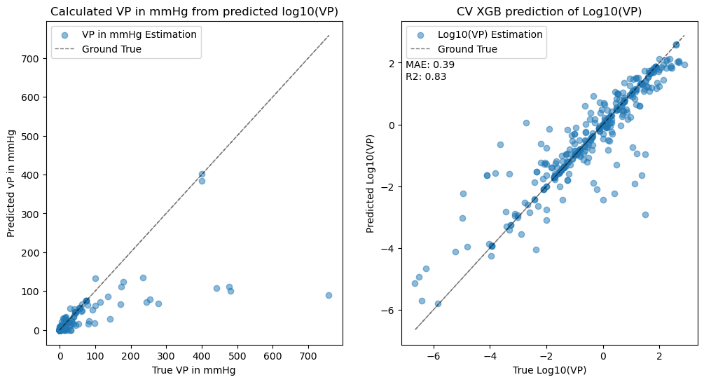
Imputing of Vapor Pressure – theoretically should improve Imax prediction
We have succeeded to retrieve 416 molecules with experimental data for VP from Pubchem, only 66 were from Wakayama dataset.

Slide 12
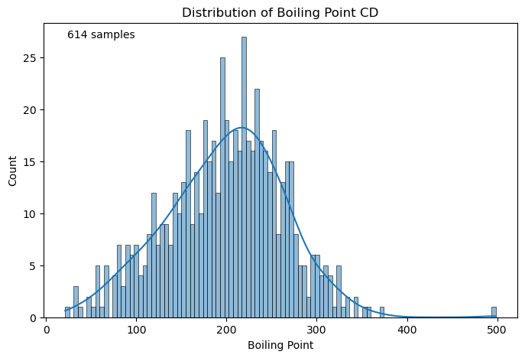
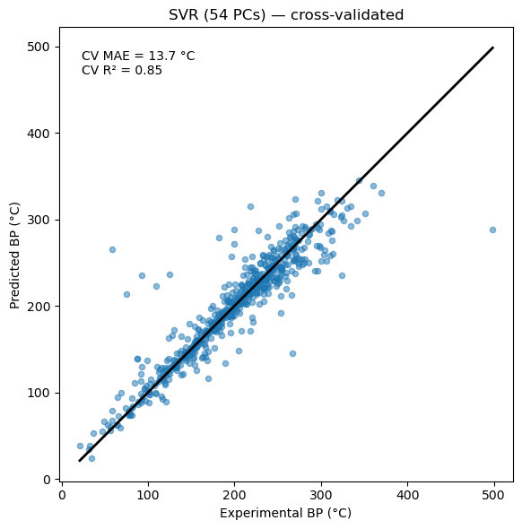
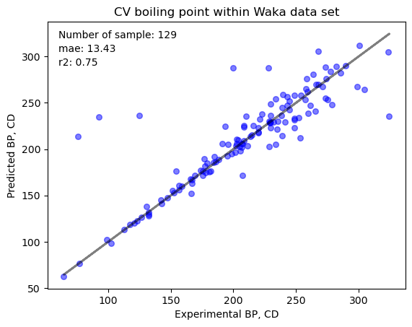
Imputing of Boiling point

Slide 13

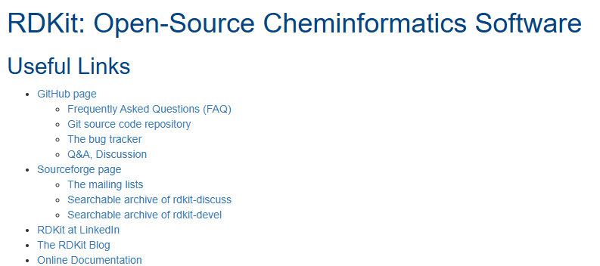
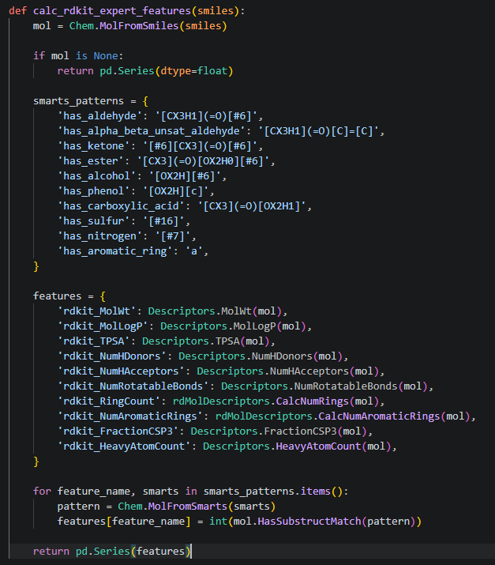

Additional Molecules features from RDKit
RDKit is an open-source cheminformatics toolkit that converts molecular structures into numerical descriptors representing properties such as molecular size, shape, topology, polarity, and hydrogen-bonding ability. These descriptors can then be used as input features for machine learning models.

Slide 14
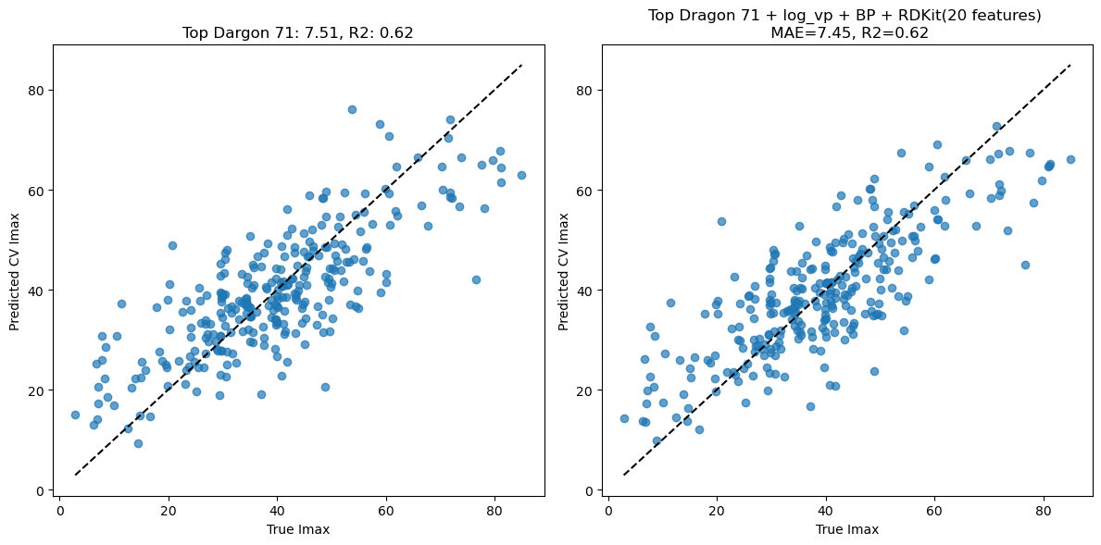
Best Results for Wakayama
Notes:
Here's what we've learned so far
✓ XGBoost is currently your strongest base learner
It captures most of the structure in the data.
✓ The classifier is meaningful
It learned something real:
no confusion between low and high intensity
class probabilities became moderately important features in XGBoost
✓ But classifier probabilities do not improve regression
We tested:
adding them as features
using them for residual correction
Neither reduced CV MAE.
So I would remove that branch from the production pipeline.
This is actually a useful negative result—it tells us where not to spend more time.

Slide 15
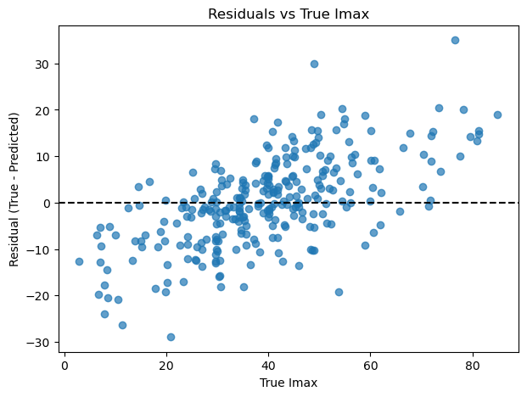
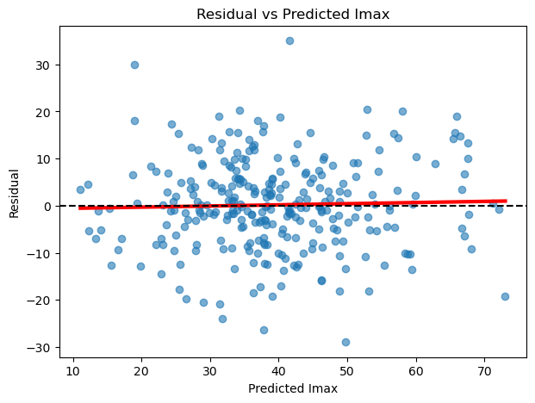
Residuals analysis

Slide 16
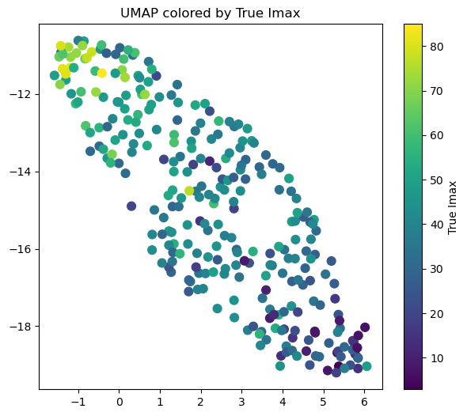
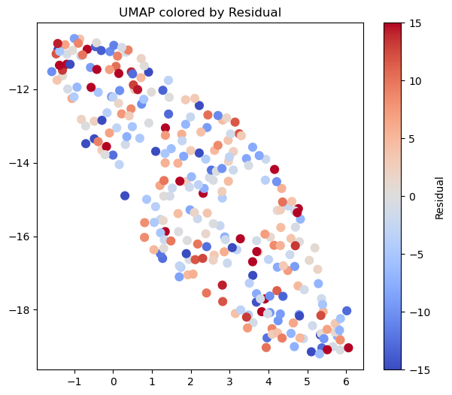
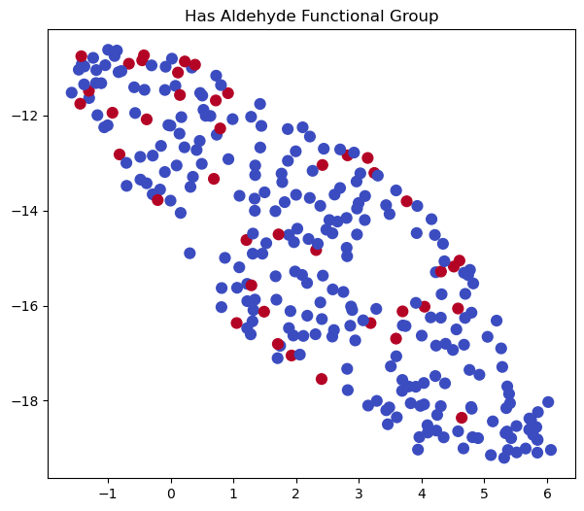
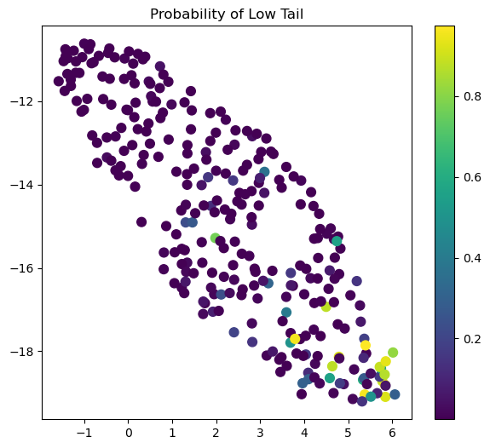
UMAP

Slide 17
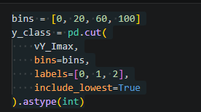
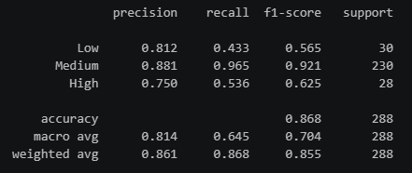
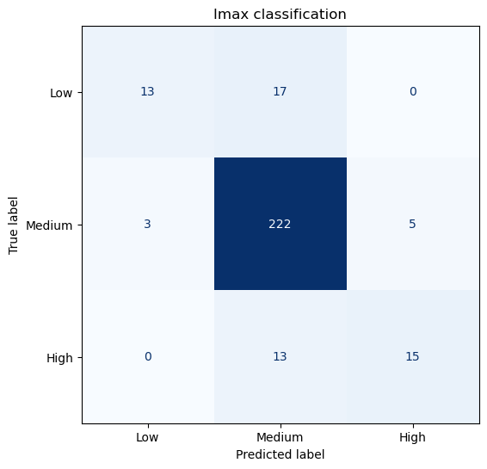


Classification with XGBOOST

Slide 18
Main trials to improve the results
Hypothesis | Bast MAE (LMS) | R2
Dummy (strategy = ‘mean’) | 12.137 | -0.008
Dragon top 71 features - XGBoost | 7.51 | 0.62
Base + log(VP) - XGBoost | 7.69 | 0.61
Base + log(VP) + BP - XGBoost | 7.77 | 0.6
Only log(VP) - XGBoost | 9.97 | 0.3
71 features - CatBoost | 7.59 | 0.62
71 features + log(VP) + BP + RDKit(20) features | 7.37 | 0.63
Umap as additional features | 7.71 | 0.61
Random forest | 7.76 | 0.60
SVR Kernel | 8.04 | 0.59
Gaussian Process | 7.94 | 0.59
Stacking + GPR | 7.71 | 0.61
Tail specialist regressors (Separate regressors for low/high tails) | 7.57 | 0.61
Tail residual experts (Correct only low/high intensity molecules) | 7.53 | 0.62
Global residual learning (Predict residual from classifier outputs) | 7.53 | 0.62

Slide 19
Main findings
Best model: XGBoost + optimized Dragon/RDKit descriptors (MAE = 7.37, R² = 0.63).
RDKit descriptors provided the most meaningful improvement beyond Dragon descriptors.
Volatility-related features (log vapor pressure, boiling point) did not improve the final optimized model.
Alternative regressors (CatBoost, Random Forest, Extra Trees, SVR, Gaussian Process) did not outperform XGBoost.
Ensemble learning (stacking, residual experts, tail experts) produced little or no additional improvement.
UMAP revealed a clear chemical-intensity manifold, but its coordinates did not improve prediction accuracy.
Remaining errors are concentrated at the low and high intensity tails, suggesting that the current limitation is likely due to dataset complexity and/or psychophysical variability rather than the regression algorithm itself.

Slide 20
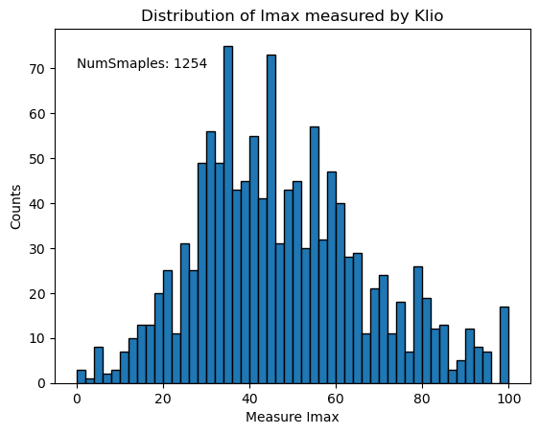
We have additional experimental data set, with more evaluations. All the evaluations are made by single perfumer during time period of 2-3 years

Slide 21
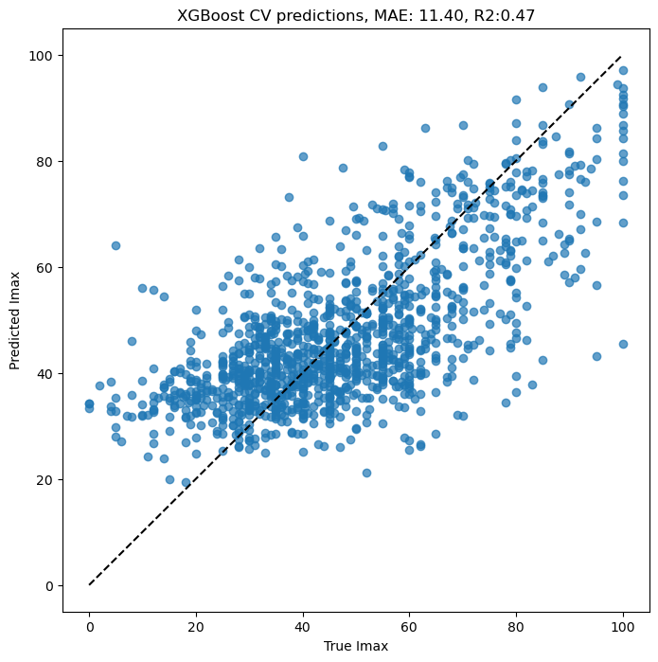
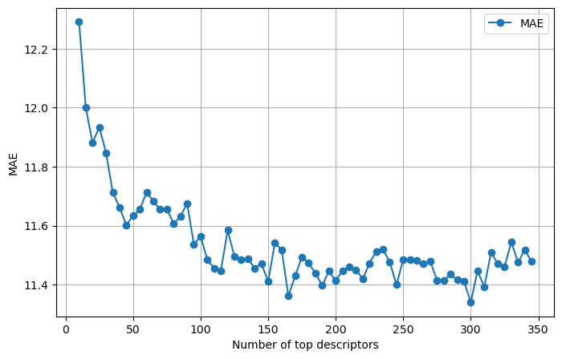
XGBOOST CV prediction of Imax based on top 165 features
Notes:
https://scikit-learn.org/stable/modules/generated/sklearn.gaussian_process.GaussianProcessRegressor.html
https://scikit-learn.org/stable/modules/generated/sklearn.ensemble.VotingClassifier.html#sklearn.ensemble.VotingClassifier

Slide 22
Possible steps for future research:
Look for additional relevant features (interaction between molecules and olfactory receptors)
Predict Di (steepness) and Ci (half intensity concentration)
Predict the full intensity curve
Use the clean and expanded database
Thank you for your attention!

